Slide 1
P2P Data Leakage (MFT Timeline)
Forensic Science – Cyber Investigations

Slide 2
Previous Presentations
0. Lab Setup
1. Disk Image and Partitions
2. Registry and File Directory

Slide 3
Objectives
Learn about
Learn about the Master File Table (MFT)
Extract
Extract the contents of the MFT.
Create
Create a timeline out of the MFT’s entries.
Learn
Learn how to filter the timeline for specific entries and/or periods of time.
Be
All timestamps will be in the UTC format.

Slide 4

6. Generate a timeline that shows activity on the system.
Tools used:
AnalyzeMFT
Mactime
Libreoffice Calc
USN Journal Parser
USN Record Carver
Fls (optional)
Log2timeline (optional)
Tsk_gettimes (optional)

Slide 5
What is the Master File Table (MFT)?
The MFT keeps records of files and folders in the volume.
All files and folders in a volume are referenced in the MFT.
The MFT is kept in a file called ‘$MFT’. This file is hidden and can only be seen by forensic tools.
Some tools that can see the $MFT: fls, ils, hex editors
The $MFT also has an entry for itself.

Slide 6
How to use icat?
icat is like cat, but with a couple of differences:
The input is an inode number instead of a file name.
The offset number (in sectors) of the disk image must be given.
If this is excluded, icat will not know which partition to look in, and it will not work.
Deleted files can be recovered.
The command:
icat –o <offset in sectors> <disk image> <inode of file>
The inode of a file can be seen in the output of fls.
Since we can identify files by their inode, we should be able to find $MFT and extract it using icat.

Slide 7
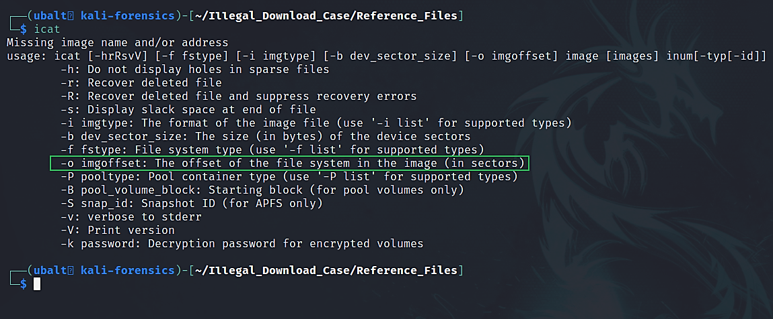
How to get help for icat?

Slide 8
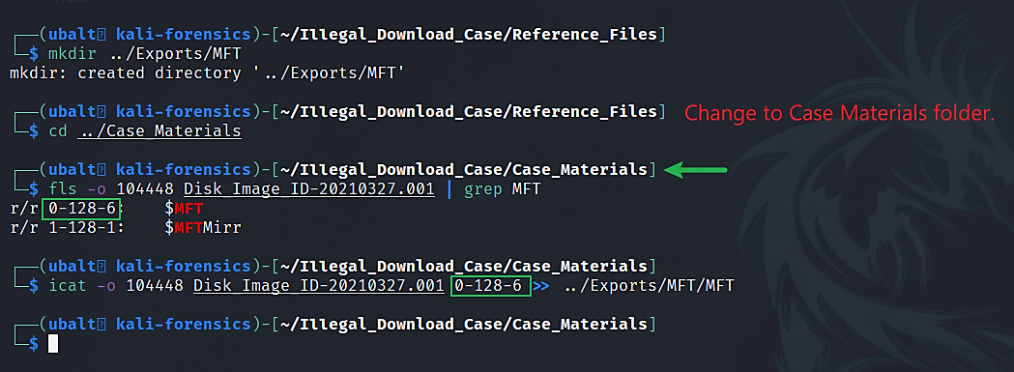
Use icat to extract the MFT.

Slide 9
How to use analyzeMFT.py.
AnalyzeMFT is a python script that parses $MFT and displays its contents in a file.
The tool requires that you point it to where the extracted $MFT is.
Specify the ‘-o’ argument so the output is directed to an output file.
Command –
analyzeMFT.py –f <MFT> -o <output file>

Slide 10
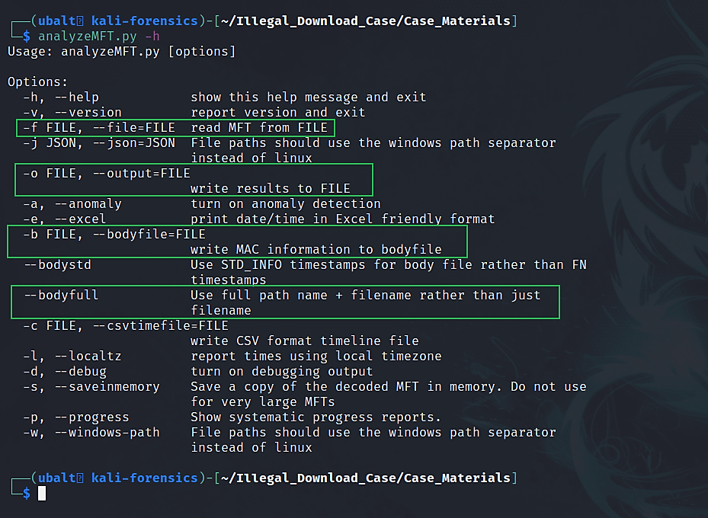
How to get help for analyzeMFT.py.
we will use the bodyfile to generate time sequence later

Slide 11
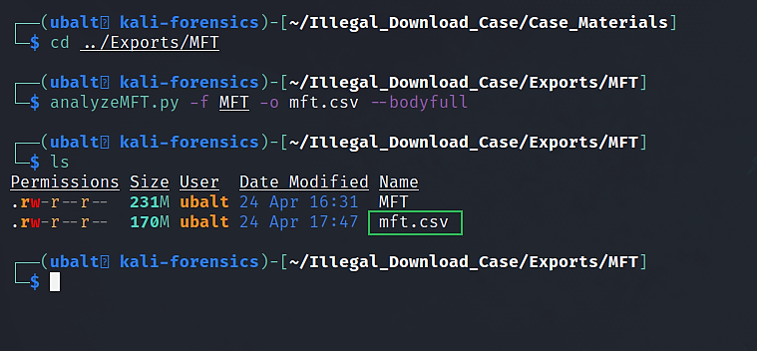
Use analyzeMFT to parse the MFT.

Slide 12
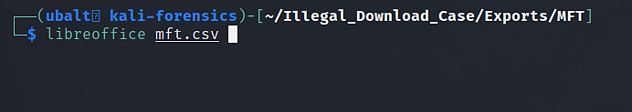
Open mft.csv in LibreOffice Calc.

Slide 13
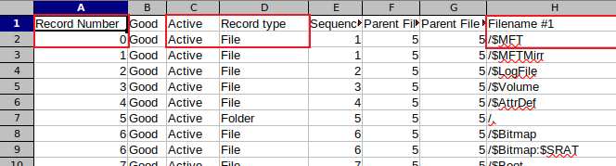
Open mft.csv in LibreOffice Calc.

Slide 14
Open mft.csv in LibreOffice Calc.

Slide 15
Layout of the MFT
The ‘record number’ column shows the inode number/entry ID for its respective file or folder.
A file or folder is considered ‘active’ if it is not deleted.
If you can access a file or folder on an NTFS volume, the MFT considers it to be ‘active.’
A file or folder is considered ‘inactive’ if it is deleted.
When a file or folder cannot be accessed on an NTFS volume, the MFT considers it to be ‘inactive’.
There are two sets timestamps for MFT entries:
$SI Info
$FN Info

Slide 16
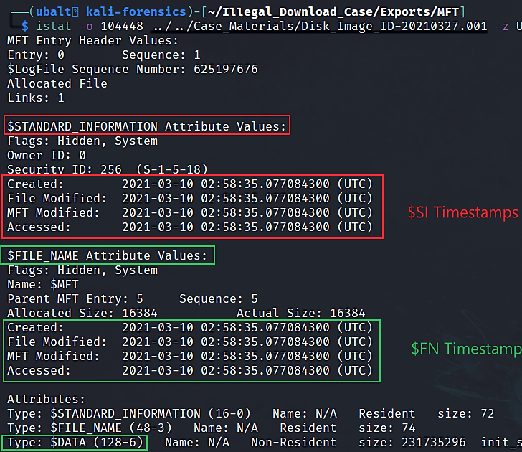
(Optional) Use istat to determine what file has the inode/record number ‘0’.
Notice that ‘(128-6)’ came after the 0 when we extracted the $MFT using icat. That is why the inode 0-128-6 refers to the $MFT. Alternatively, 0 will also refer to the $MFT.

Slide 17
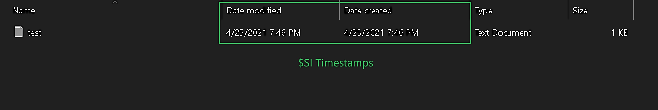
Difference between $SI and $FN Timestamps and why we care.
$SI, or $Standard_Info, are timestamps that the user sees in the file explorer.
These timestamps could be manipulated by the user.
programs can alter the timestamps of files.
When this is done, they are modifying the $SI timestamps.

Slide 18

Difference between $SI and $FN Timestamps and why we care.
$FN, or $File_Name, timestamps are not seen in the file explorer
cannot be modified by the user.
Only the system kernel can modify $FN timestamps.
Thus, we can compare the $SI and $FN timestamps to see if a user tampered with any of the timestamps.
This is an advantage with analyzeMFT.py over a tool like fls.
The timestamps with fls are $SI and do not include $FN.
Therefore, the file directory listing only contains $SI timestamps and not $FN timestamps.

Slide 19
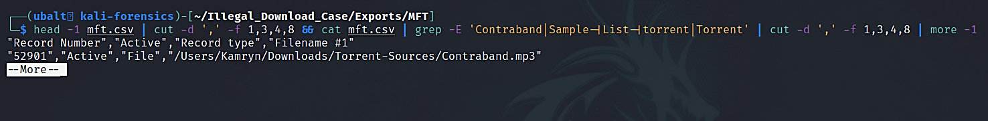
Search for files of interest in the $MFT.
Syntax: cut -d "delimiter" -f (field number) file.txt
For Contraband.mp3 located in the Torrent-Sources folder:
It’s inode/record number is 52901.
It is an active file on the file system.

Slide 20
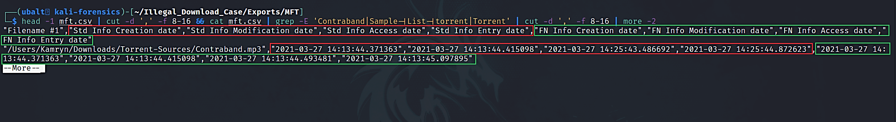
Search for files of interest in the $MFT.
For Contraband.mp3 located in the Torrent-Sources folder:
It was created on 03/27/2021 at 14:13:44.
It was modified on 03/27/2021 at 14:25:44.
It was accessed on 03/27/2021 at 14:25:43.
It was changed on 03/27/2021 at 14:25:44. (This means that the MFT entry was changed.)

Slide 21
Explanation
The files of interest we identified from the file directory listing are active on the system.
By comparing the $SI and $FN timestamps, we can conclude that Kamryn did not use a program to alter any of the $SI timestamps.
You can check this by looking at mft.csv or by using icat.
There are a lot of timestamps dated on March 27th. When we create a timeline, we should be looking for dates starting from March 10th to March 27th.
Notes:
https://community.rsa.com/t5/rsa-netwitness-platform-blog/do-you-mft-here-s-an-mft-overview/ba-p/519885#:~:text=The%20MFT%20Entry%20Modified%20is,this%20MFT%20Entry%20Modified%20timestamp.

Slide 22
How to use mactime.
mactime can create timelines from ‘body files’.
A tool will specify whether or not it has the option to output contents in the ‘body file format’. In the case of analyzeMFT, we used the ‘-b’ argument to output the $MFT’s contents to a body file.
You can specify the dates that you want the tool to create a timeline out of.
For example, if you wanted to only get information from March 10 to March 13, you have the option to do that with this tool.
Command –
mactime –d –b <body file> -z UTC 2021-03-10..2021-03-28

Slide 23
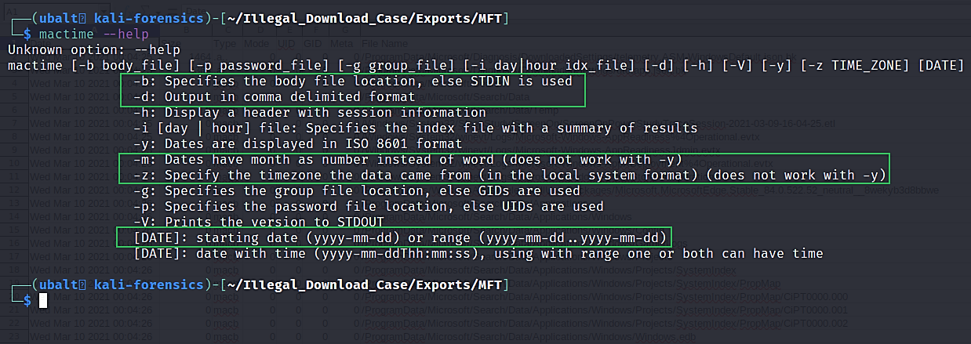
How to get help for mactime.

Slide 24
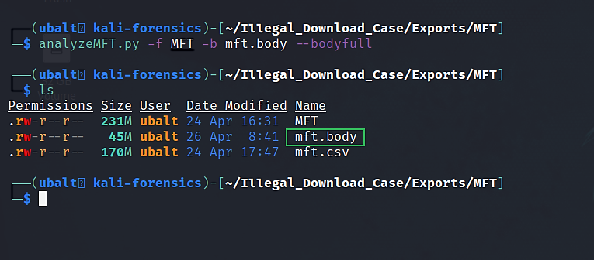
Use analyzeMFT to generate a body file.

Slide 25
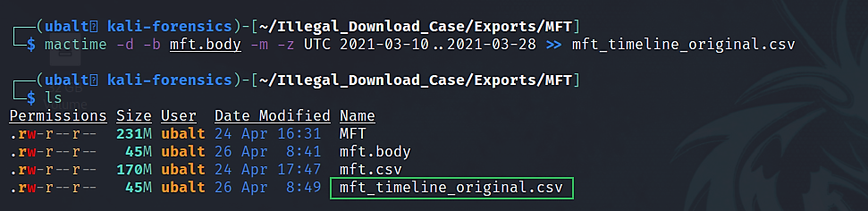
Use mactime to generate a timeline of the MFT entries.

Slide 26
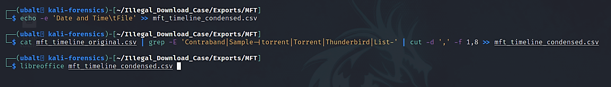
Analyze the timeline for files of interest.
add header for readability

Slide 27
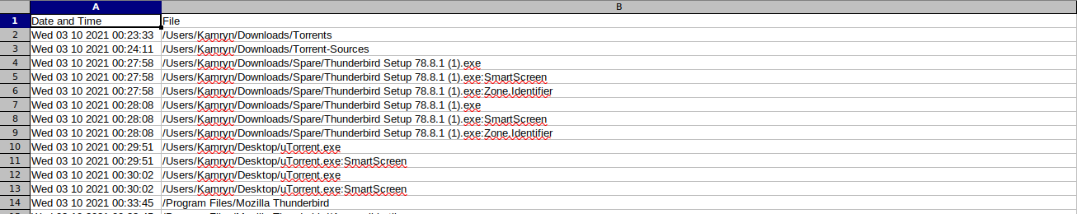
(Option 1) Analyze the timeline for files of interest in LibreOffice calc or other spreadsheet application.
Note: The timeline lists the earliest dates at the top and the most recent dates at the bottom. The timestamps are for the creation dates.

Slide 28
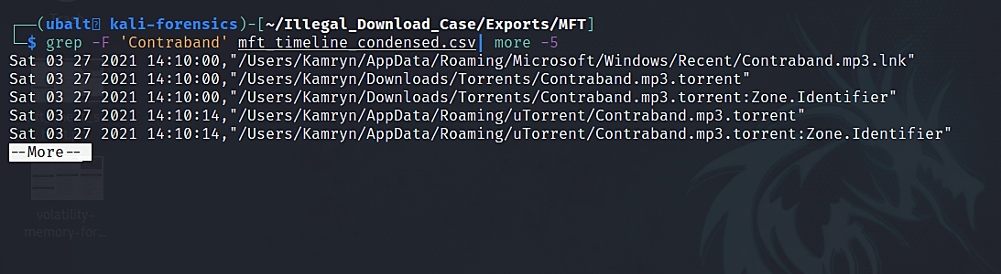
(Option 2) Analyze the timeline for files of interest in the terminal.
This shows Contraband.mp3.torrent being created on 03/27/2021 at 14:10.00 (2:10:00 UTC time).

Slide 29
Explanation
By looking at this timeline, you can see the file activity on the volume.
For example, if you grep for Contraband, you can see every instance of Contraband.mp3 and Contraband.mp3.torrent appearing on the file system.
For every file that catches your interest in the investigation, you can reference this timeline and see when it appeared and where it is located.
Also, by extracting the MFT, you have each file’s inode/record number. You can use istat to retrieve timestamps and icat to extract a file to analyze it further.

Slide 30
Brief overview for files of interest.
File Name | Date/Time It Appeared on the System | # of Entries | File Path
uTorrent.exe | 03/10/2021 @ 00:29:51 | 3 | /Users/Kamryn/Desktop
thunderbird.exe | 03/10/2021 @ 00:33:47 | 1 | /Program Files/Mozilla Thunderbird
Sample-1.mp3 | 03/21/2021 @ 20:40:15 | 5 | /Users/Kamryn/Downloads
Sample-1.mp3.torrent | 03/21/2021 @ 20:42:38 | 3 | /Users/Kamryn/Downloads/Torrents
Contraband.mp3.torrent | 03/27/2021 @ 14:10:00 | 2 | /Users/Kamryn/Downloads/Torrents
Contraband.mp3 | 03/27/2021 @ 14:13:44 | 6 | /Users/Kamryn/Documents/Reference/Work
Note: This is not a complete timeline of the events.

Slide 31
What do we gain from this timeline?
uTorrent.exe was recorded on the file system on 3/10/2021 at 00:29:51. This could mean that Kamryn installed uTorrent on this date and around this time.
Similarly, by looking at the timestamps for the torrent files, we can conclude that Kamryn either created or downloaded these files at or around those times.
We can get more information about these files from the USN Journal.

Slide 32
Alternate ways of answering the question.
You could use fls -m. Instead of what we got when we made the file directory, you would get a body file of those entries. However, you will only get $SI timestamps.
tsk_gettimes gets the same result as fls –m. The only difference is that tsk_gettimes will put vol3 in front of the file path (ex. vol3/Users).
Log2timeline is a very powerful tool that can parse the MFT. However, a new user could be overwhelmed by the number of options it has.

Slide 33
Next Presentation
USN Journal Timeline

